Slide 1
GPU Accelerated Multilayer Perceptron Implementation
By Max Robinson

Slide 2
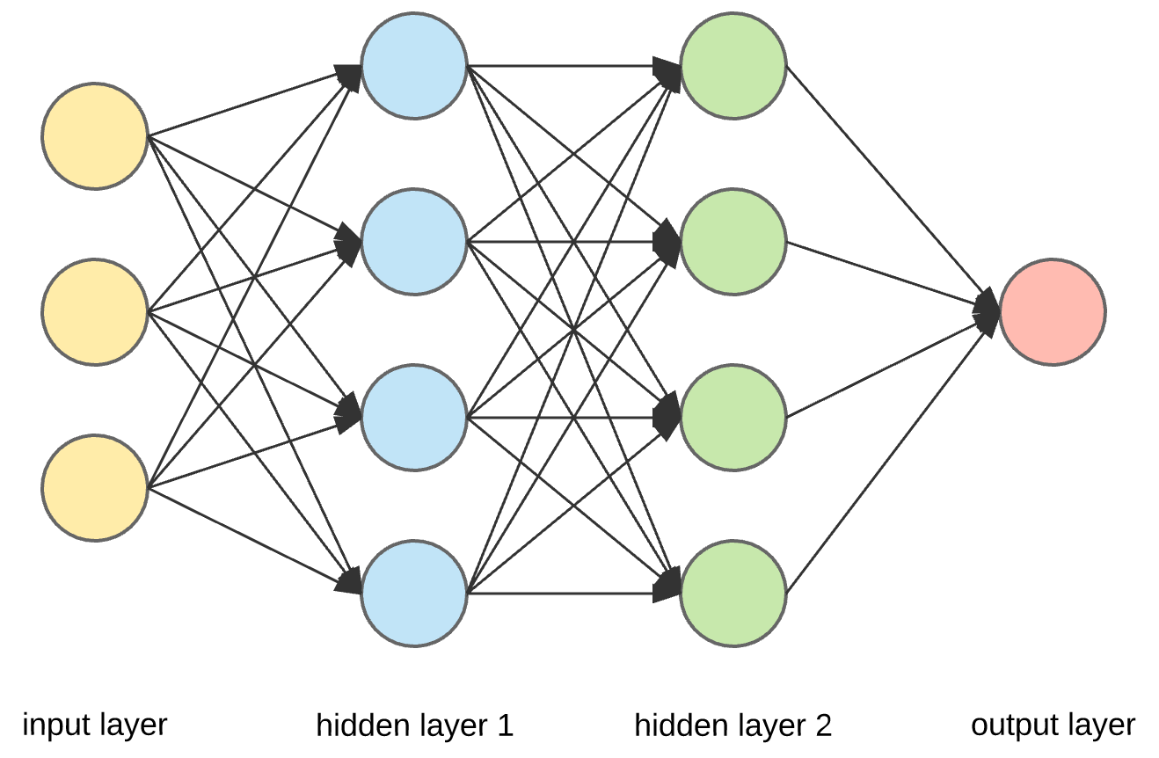
What are Artificial Neural Networks & Multilayer Perceptrons?
An architecture and framework for learning.
Useful for:
Classification
Regression
Non-linearly separable data
Notes:
https://towardsdatascience.com/applied-deep-learning-part-1-artificial-neural-networks-d7834f67a4f6

Slide 3
Motivation
Multilayer Perceptrons can be implemented using matrices and matrix multiplication
Matrix operations are highly parallelizable on a GPU
Implementation on a GPU should be both possible and parallelizable on a GPU
Possible to see performance speed ups even with large networks

Slide 4
Background

Slide 5
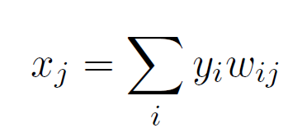
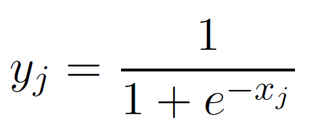
Multilayer Perceptron Calculations
Two parts to training a Multilayer Perceptron
Feedforward
Back Propagation
Feedforward

Slide 6

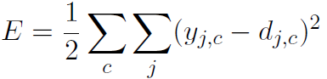
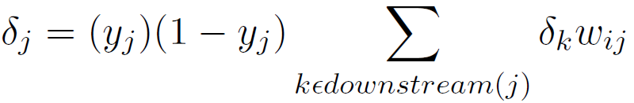
Back Propagation with Gradient Descent
Error Function
(Squared Error)
Output Layer Error
Output Layer Error

Slide 7
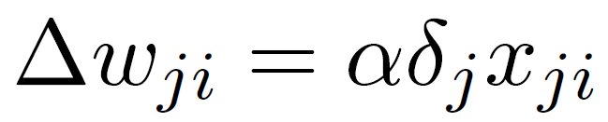

Back Propagation Update Functions
Delta weights for output layer
Delta weights for hidden layer
Update weights
$$w_{ji}=w_{ji}+Δw_{ji}$$

Slide 8
Implementation

Slide 9
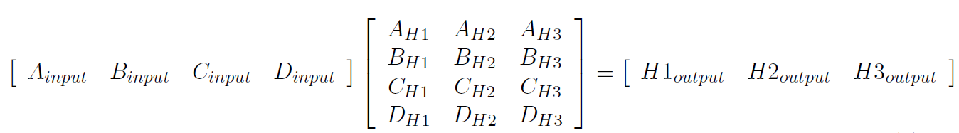
Matrix Representation
input
H
A
1
B
2
C
3
D

Slide 10
Code Details
Two major parts to the program
Forward Pass
Back Propagation
Forward Pass
Use cublasSgemm to do a series of matrix multiplications
Custom Kernel for Logistic / Sigmoid function
Back Propagation
Custom Kernels for error calculations
Custom Kernels for weight updates

Slide 11
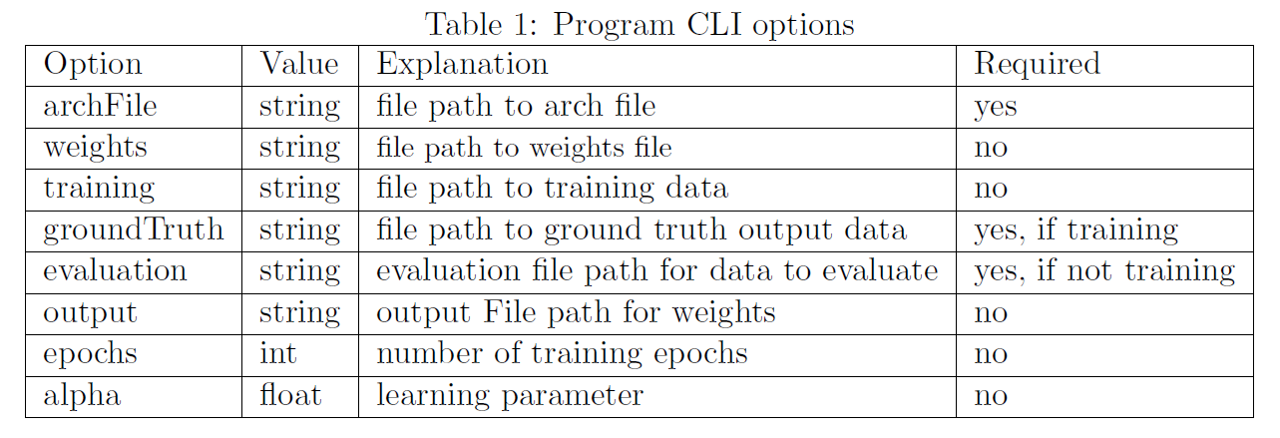
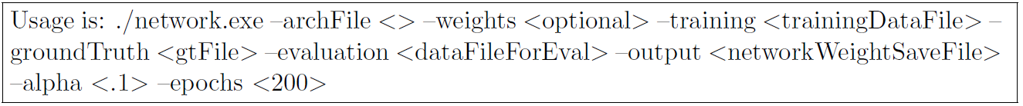
Running the Program

Slide 12
Code Walk Through

Slide 13
Evaluation

Slide 14
Method
Two Evaluations
Accuracy
Speed
Accuracy
Test that the implementation is capable of learning in a classification problem
Speed
Compare the implementation speed to an existing commercial implementation

Slide 15
The Data
Dataset built for Face Recognition
Faces come from celebrity face image dataset
(Liu, Luo, Wang, & Tang, 2015)
Faces are embedded into a 128 by 1 vector using OpenFace
(Amos, Ludwiczuk, & Satyanarayanan, 2016)
Data is labeled as a 1’s hot encoding for 3 options
Anderson Cooper, Scarlett Johansson, or someone else
188 training data points, 94 test data points

Slide 16
Metrics
Accuracy
Error rate = # misclassified instances / total number of instances
Speed
Avg Time per epoch
Avg Time per compute
Avg Time per forward pass

Slide 17
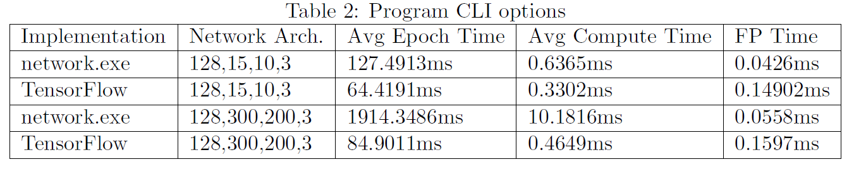
Results
Accuracy
2% error rate on test set of 94 data points
Speed

Slide 18
Conclusion
GPU Implementation capable of learning to classify data points
Implementation is not as fast as a highly optimized CPU one
With some adjustments to back propagation implementation, might be able to close the gap in speed difference.

Slide 19
Thanks!

